Slide 1
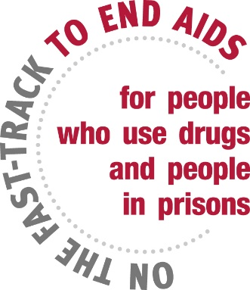
Towards a Conducive Legal and Structural Environment
for HIV Services: Responding to the needs of women in prisons & women who inject drugs in Afghanistan, Nepal and Pakistan
Fariba Soltani
Senior Expert - Portfolio Manager
HIV/AIDS Section
United Nations Office on Drugs and Crime

Slide 2
I am a woman who uses drugs and…
I am subjected to forced sterilisation or abortion
I don’t feel comfortable going to HIV service points run only by male staff
I often have to sell sex to get drugs and inject drugs with the needle used by my partner
I fear losing custody of my child
I have to get permission from my family members or spouse to access services
Health-care workers do not trust me, as if I just want drugs
I often face violence including sexual violence, even from people who should protect me
I am treated as a criminal - I don’t feel safe going to health centres due to fear of arrest

Slide 3
I am a woman in prison and…
I was gang raped when I first arrived here
We have no methadone here, so I started injecting drugs again
I have been locked up without a trial for months
I am pregnant & living with HIV. My treatment stopped since I came here. I don’t want my child to be born with HIV
I also inject drugs with used syringe & needle as we can’t get sterile needles-syringes here
We don’t have access to sexual and reproductive health care services
I am forced to have sex to get any incentive or earned privilege

Slide 4
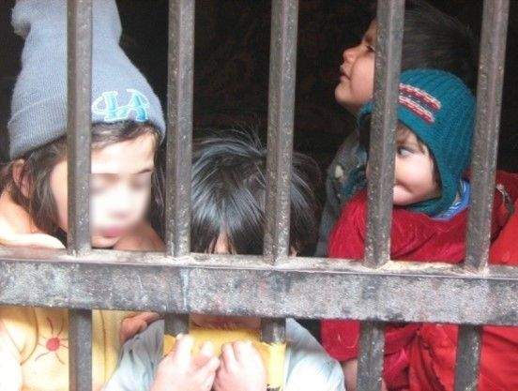
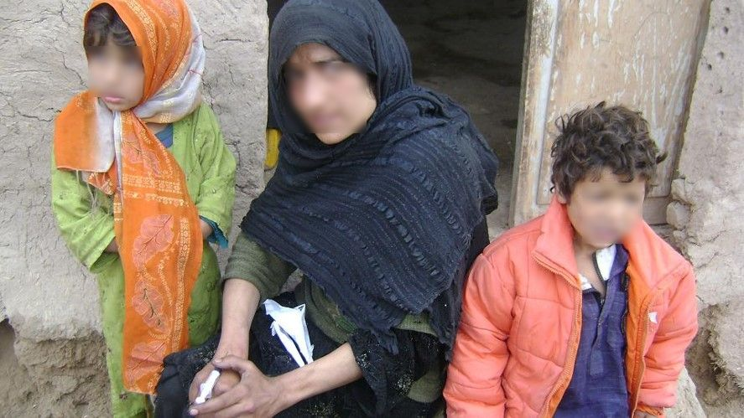
Unsafe injecting drug use is main mode of transmission of HIV and HCV in these three UNODC project countries
No specific services existed for women who use drugs or women in prisons before this program started in 2008

Slide 5
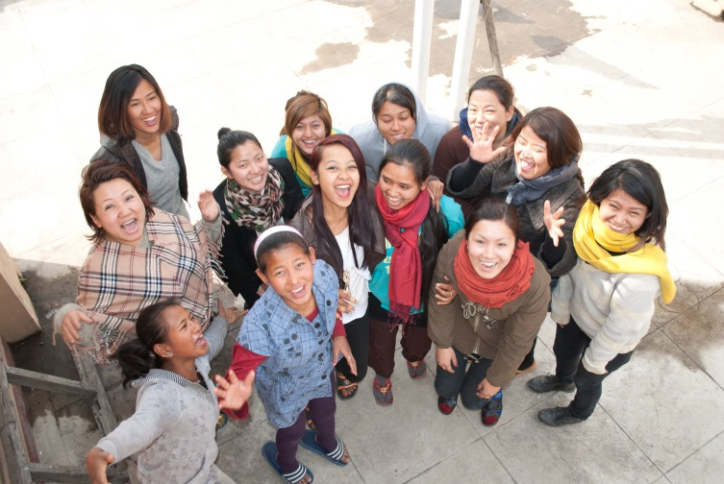
UNODC support to countries: Using the human rights & gender lenses
Review drugs & criminal justice law, policies & practices to determine if they have a negative impact on women
Ensure that HIV policy and programme are gender responsive
Consider effective & humane approaches, e.g. alternatives to imprisonment for women, including for those who use drugs
Involve & support CSO & CBO representing women who use drugs in programme design, implementation, monitoring & evaluation
Implement & enforce measures to prevent violence, including sexual violence, both in community and in prisons

Slide 6
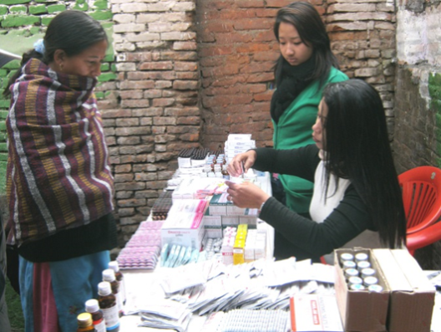
Gender-responsive programming
Comprehensive HIV services, including harm reduction
Capacity building
Advocacy
Operational research
Monitoring and Evaluation

Slide 7
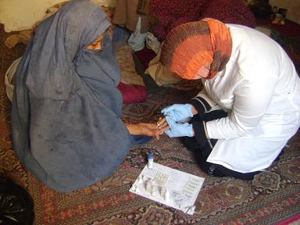
AFGHANISTAN

Slide 8
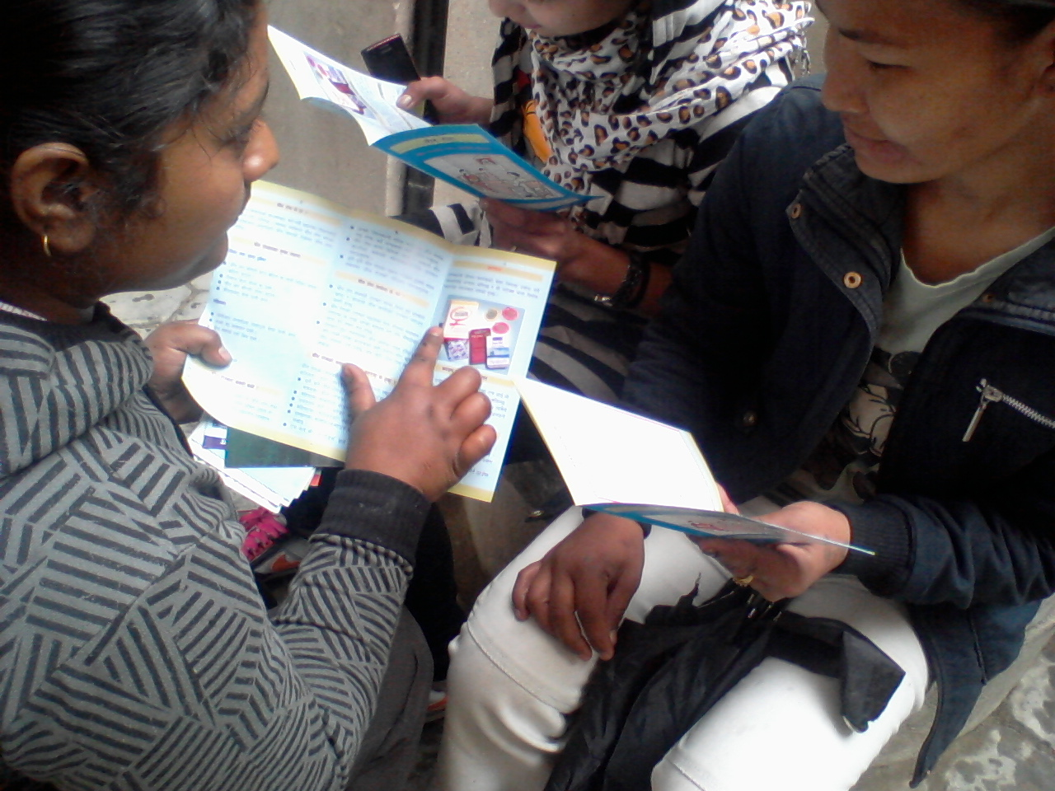
NEPAL

Slide 9
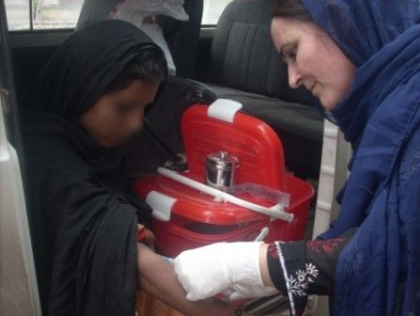
PAKISTAN

Slide 10
Sustainability: Multi-layered
Governments acknowledge the needs of these vulnerable women
Advocacy and trainings have had long standing effects
Supported legal and policy reforms
Included in Global Fund proposals in countries, BUT didn’t receive the needed resources
Still large gaps in service provisions remain

Slide 11
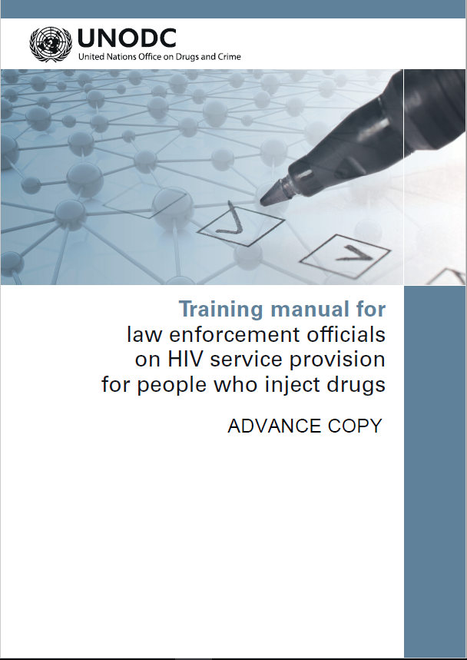
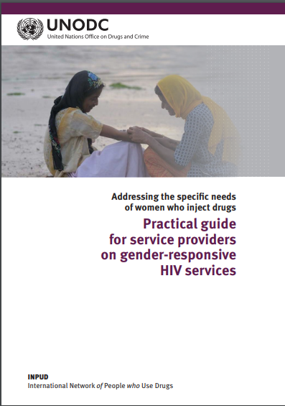
RESOURCES ARE AVAILABLE

Slide 12
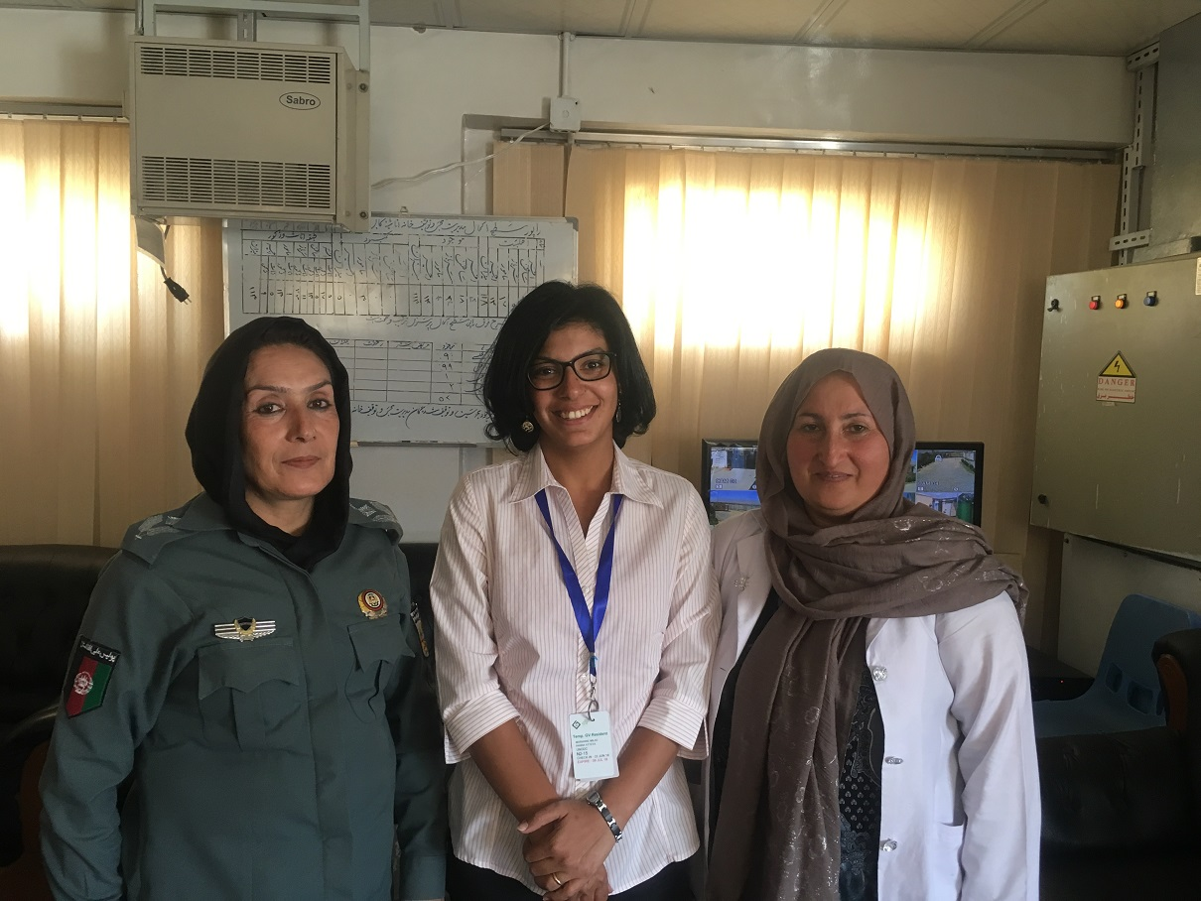
Happening now!

Slide 13
Thank You
@UNODC_HIV

